Slide 1
LOGICAL REASONING
FLOWCHART

Slide 2
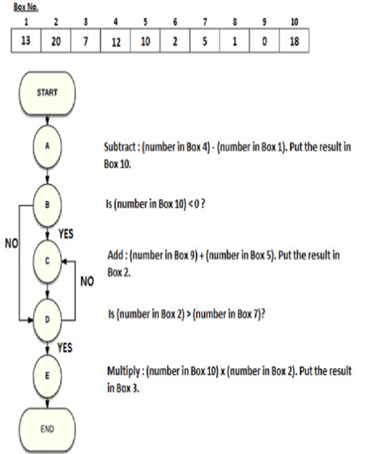
LOGICAL REASONING

Slide 3
LOGICAL REASONING
Q. 1 At the end of the flowchart, what will be the number stored in Box 4?
Q. 2 At the end of the flowchart, what will be the number stored in Box 3?
Q. 3 At the end of the flowchart, the number in all of the following boxes will change; except:

Slide 4
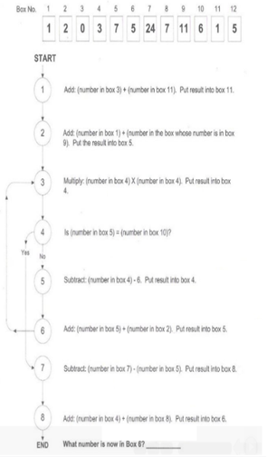
LOGICAL REASONING

Slide 5
Q 1. what number is now in box 6?
24
25
26
27

Slide 6
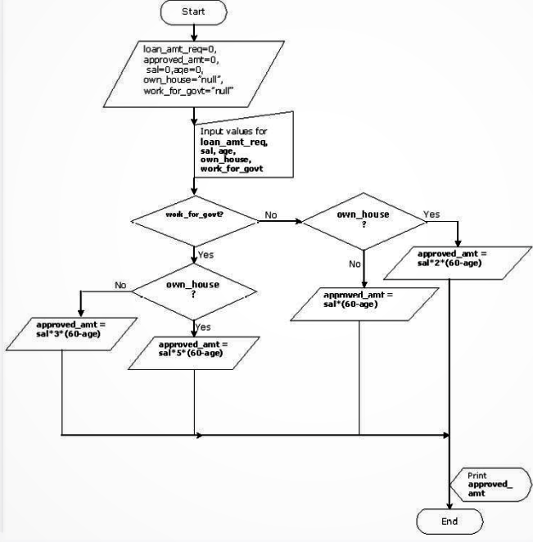
LOGICAL REASONING

Slide 7
Q 1. For an individual who works for a government organization and owns a house. It is given that he is 35 years old and earns Rs. 15000 per month. What would the approved_amt for him
1875000
1975000
1825000
2075000

Slide 8
Q 2. A person wishes to avail a loan of Rs. 5000000. He works for a government organiations and does not own a house. Would he get the loan if he draw a salary of Rs. 60000 and his age is 28 years. If he does get a loan what amount would he be entitled? If not by what amount he would be shor of the required amount?
Yes he would get a loan equal to Rs 5000000
Yes, he would get a loan equal to Rs 5760000
No, he would not get a loan he would be short of Rs 70000
No, he would not get a loan he would be short of Rs. 760000

Slide 9
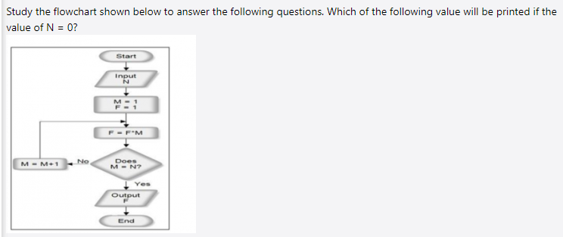

Slide 10
Q 1. which of the following value will be printed if N=0?
ZERO
720
5040
NONE OF THESE

Slide 11
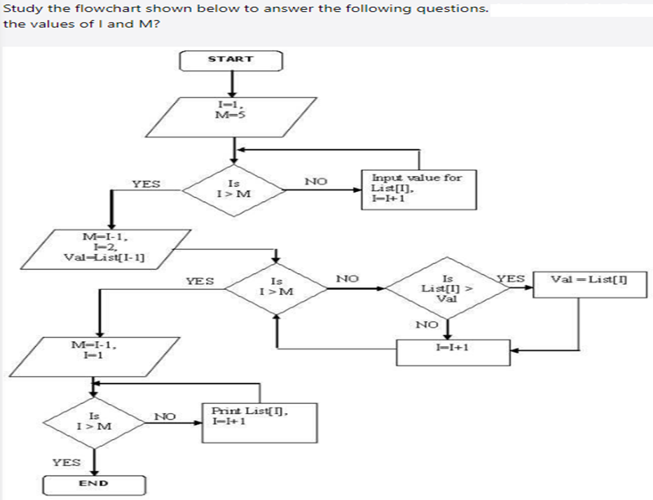

Slide 12
Q 1. At the end of the flowchart execution, what would be the values of I and M?
I=1 and M=1
I=6 and M=5
I=5 and M=5
I=15 and M=19

Slide 13
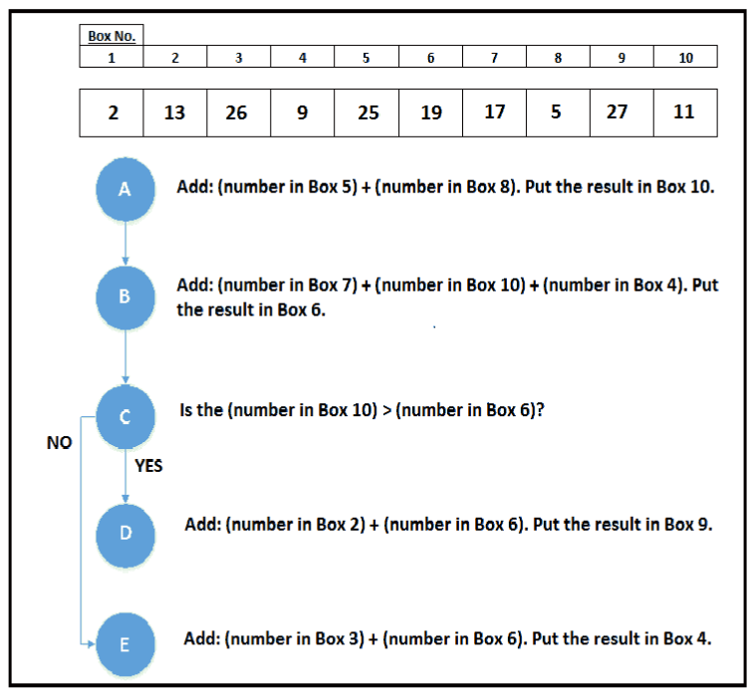

Slide 14
Q1. At the end of the flow chart, what is the number stored in the Box 9?
Q2. At the end of the flow chart, what is the value of number stored in the box whose number is stored in Box 8?
Q3. At the end of the flowchart, determine the value of the following expression. (Number in Box 1) x (Number in Box 4) - (Number in Box 6) - (Number in Box 10)

Slide 15
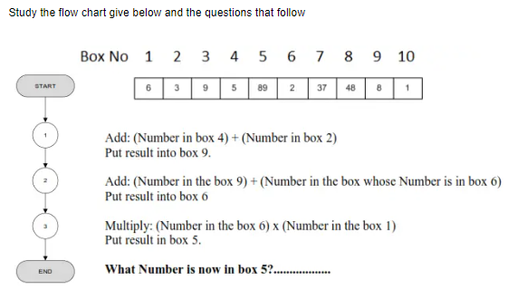

Slide 16
Q 1. What number is now in box 5?
66
56
65
None of these

Slide 17
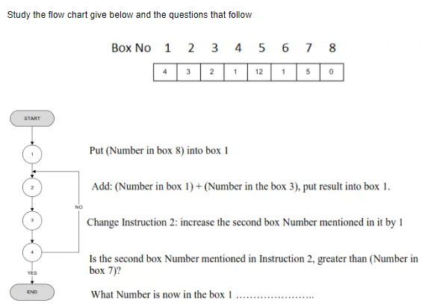

Slide 18
Q 1. What number is now in box 1?
32
15
14
NONE

Slide 19
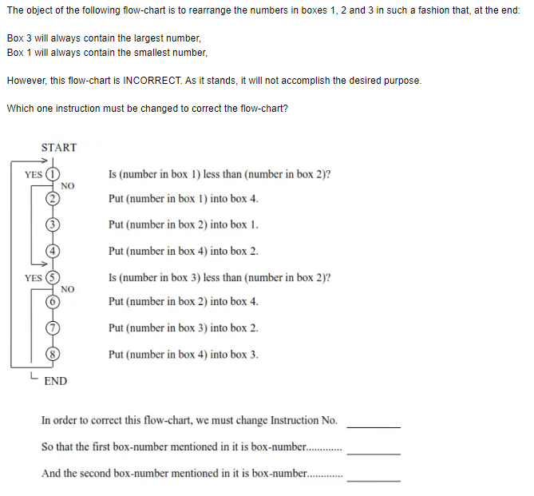

Slide 20
LOGICAL REASONING
Q 1. fill the blank spaces
In order to correct this flow-chart, we must change instruction No.---------
So that the first box number mentioned in it is box number------------
And the second box number mentioned in it is box number------------
Instruction 5 box 2 and box 3
Instruction 5 box 3 and box 2
Instruction 4 box 2 and box 3
None of these

Slide 21
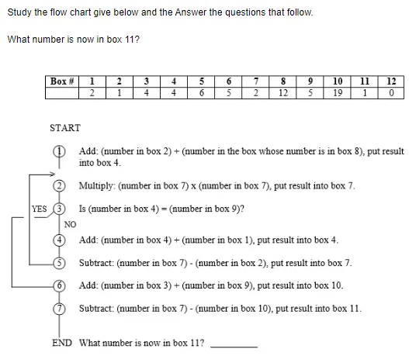

Slide 22
Q 11. What number is now in box 1?
55
15
58
NONE

Slide 23
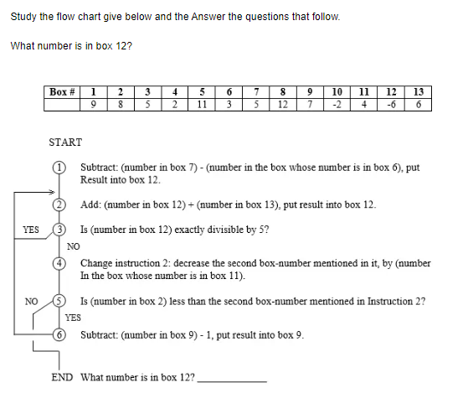

Slide 24
Q 1. What number is now in box 12?
12
19
58
NONE

Slide 25
ANY DOUBTS

